Slide 1

B.E. PROJECT Image Segmentation and Text Recognizer Using Deep Learning:
Presented by
Ishan Modi (N18018)
Ishan Srivastav (N18068)
Janhavi Panambor (N18057)
Under the guidance of
DR. VARSHA DEGAONKAR
BE (Electronics and Telecommunications)
Dept. of Electronics and Telecommunication
Hope Foundation’s
International Institute of Information Technology Hinjawadi Pune

Slide 2

Introduction
Focuses on
Deep learning.
Digital Image Processing.
Object Classification through comparisons.
Automation.

Slide 3
About Deep Learning
Comes under Ai
Subset of Machine Learning
How it works
Ease of accessing and processing the data
Decision Making using creating patterns and processing data.
Studying unsupervised data
Cloud Data Storage
Hierarchical neural networks for transferring data

Slide 4

Difference between ML and Deep Learning
 | ML | DEEP LEARNING
Human Intervention Hardware Time Approach Applications | requires more ongoing human intervention less complex quick operation but limited efficiency structured data Email inbox, banks, etc. | requires minimal intervention more complex fast operation and faster results unstructured data self - driving cars, robots

Slide 5
Digital Image Processing
Digital image processing is the use of a digital computer to process digital images.
DIP is a software which is used to manipulate the digital images by the use of computer system.
It can also be used to enhance the images, to get some important information.
Digital Image Processing provides a platform to perform various operations like image enhancing, processing of analog and digital signals, image signals, voice signals etc.

Slide 6
Advantages of Digital over Analogue Image Processing
Better Quality Images
Less data consumed
Less costly
Fast Image storage and retrieval process

Slide 7
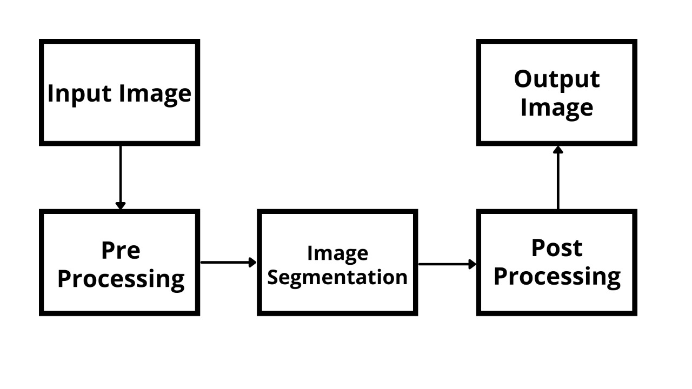
About
The stepwise Procedure

Slide 8
About
Input Image
Capturing data through images.
Pre - processing
Removal of unwanted distortions and feature enhancement.
Image Segmentation
Classification of objects and labelling.
Post – processing
Feature enhancements such as smoothening of image.
Output Image
Displaying the segmented objects. (Humans, Objects)

Slide 9
Expected Outcome
A web based application which can analyze the images captured by the camera and detect their classification using the machine learning model into objects, humans, and various other types.

Slide 10
Impact and Limitations
Positive Impact: The system will help us detect and segment objects. This particular system can be further classified for many applications including healthcare, security and automation.
Negative Impact: The efficiency of the system might be reduced if the model is not trained enough.

Slide 11
Future Scope
Implementation of clarity and noise diminishing. For better security and surveillance systems.
The system can be developed further to be implemented into satellite systems. This in turn can enhance GPS applications.
For healthcare applications, the project can be used for medical imaging and hence to detect different types of tumors.

Slide 12
Future Scope
The system can be used in self-driving cars for giving easy distinctions between various objects. Be it traffic signals, signboards, humans, and cars. It can help the driving instruction algorithm to better assess the surrounding before generating the next instruction.
The system can be used to detect defects in circuit board. A company has to bear the responsibility of defected devices. If a camera backed with an Image Segmentation model keeps scanning for defects produced in the final product, a lot of money and time can be saved in fixing a defective device.

Slide 13
References
flatironschool.com
investopedia.com
javatpoint.com
Wikipedia.com
Kaggle.com
Tutorialspoint.com

Slide 14
THANK YOU

